Slide 1
STAT 654 · Texas A&M University
Quantifying Dataset Leakage in Fake News Detection
A Case Study on the ISOT Dataset
Hareen Sai Vatikuti · Raj Purohith Arjun · Venkateswarlu Nagineni
ISOT Dataset · 44,898 Articles · Phase 1–4 Results

Slide 2
Presentation Outline
Phase 1
Data Loading, Leakage Detection & Temporal Analysis
Phase 2
Feature Engineering: Length, Vocabulary, Readability & Sentiment
Phase 3
Feature Tracks: Leaky Baseline, Decontaminated TF-IDF & Linguistic Style
Phase 4
Model Training: LR, Naïve Bayes, SVM, Random Forest, LightGBM
Up Next
Phase 5 — Ensemble, Error Analysis & Final Evaluation

Slide 3
Phase 1 — Dataset Overview
ISOT Dataset · 44,898 Articles
44,898
23,481
21,417
1.096
6,252
Total Articles
Fake (0)
Real (1)
Imbalance Ratio
Duplicate Texts
Dataset Columns
⚠ Label Leakage Findings
title
(object)
Article headline
Subject column:
5-fold CV accuracy = 1.000 — perfect predictor
text
(object)
Body content
Reuters byline:
99.8% of Real articles contain 'reuters'
subject
(object)
⚠ Leaks label perfectly
Single-word acc.:
has_reuters feature → 99.2% accuracy
date
(object)
Only fake articles parseable
Temporal bias:
Only Fake articles have parseable dates (2015–2017)
label
(int64)
0 = Fake, 1 = Real
Verdict:
Models trained on raw data detect SOURCE, not linguistic deception

Slide 4
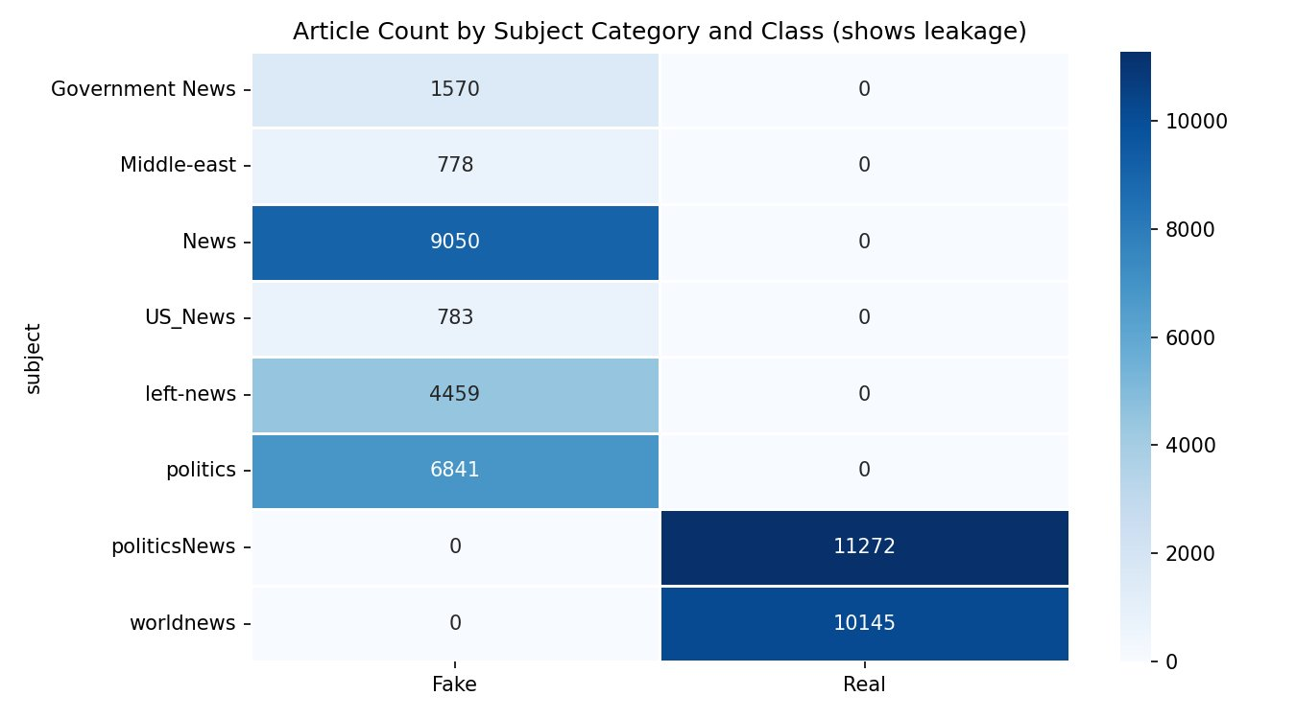
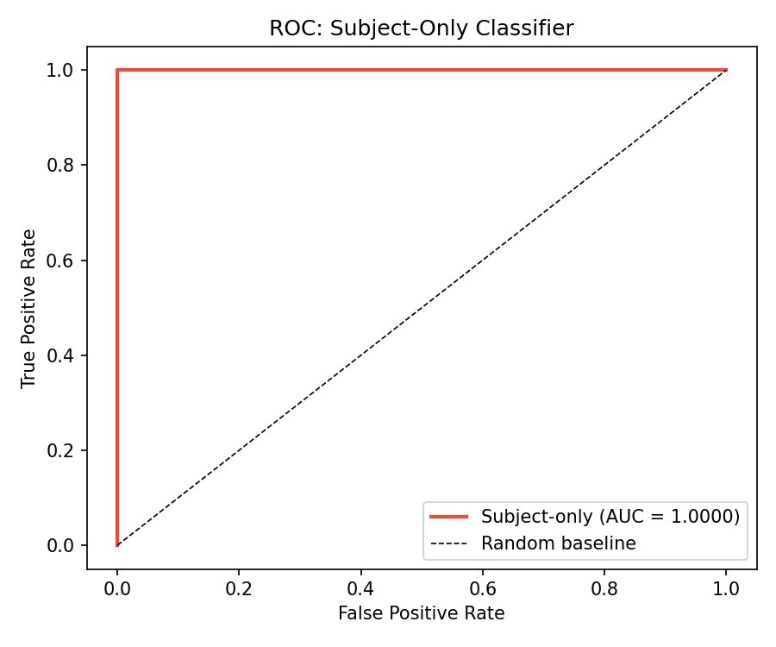
Phase 1 — Subject Column: Perfect Label Leakage
Key Finding:
Subject categories perfectly separate Fake vs Real (AUC = 1.00). All fake articles fall under 'Government News', 'politics', 'News', etc.; all real articles under 'politicsNews' or 'worldnews'. → Subject must be excluded from all models. Reuters byline similarly excluded.

Slide 5
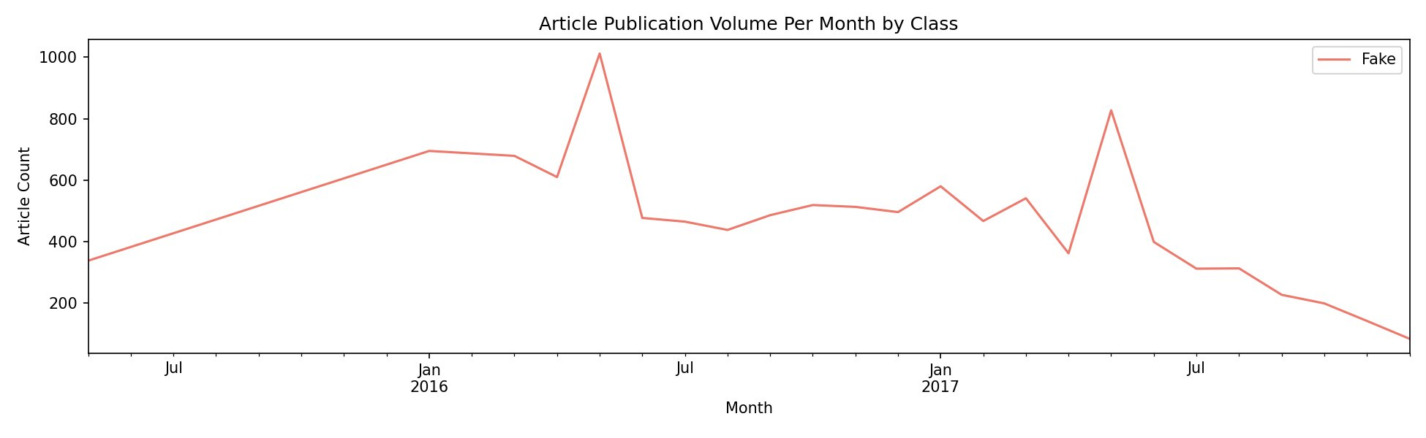
Phase 1 — Temporal Analysis & Duplicate Content
33,030 Missing Dates
Fake: 2015–2017 Only
6,252 Duplicate Texts
Majority of entries have unparseable or missing publication dates — temporal features excluded from all model tracks
Fake articles have parseable dates spanning 2015–2017 only. Real articles lack consistent temporal coverage — strong temporal bias
6,252 duplicate body texts and 6,169 duplicate titles identified. 6,852 near-duplicates via shared prefix — reduces effective diversity

Slide 6
Phase 2 — Feature Engineering & Hypothesis Testing
Feature
Fake Median
Real Median
MW p-value
Effect (rb)
Bonferroni threshold: p < 0.0083
Significant
word_count
363
359
3.29e-13
−0.040
✓
avg_word_len
4.946
5.170
0.00e+00
+0.401
✓
type_token_ratio
0.590
0.607
1.31e-145
+0.140
✓
title_words
14
10
0.00e+00
−0.747
✓ (largest)
char_count
2166
2222
2.14e-02
−0.013
✗
unique_words
216
215
1.57e-07
−0.029
✓
Flesch Ease
FK Grade
VADER Compound
Excl. Density
51.5 (Fake) vs 42.8 (Real)
10.9 vs 12.7
−0.19 vs +0.26
Both ≈ 0
Fake news easier to read
Real uses higher grade level
Fake = more negative sentiment
Sig. difference at p≈0

Slide 7
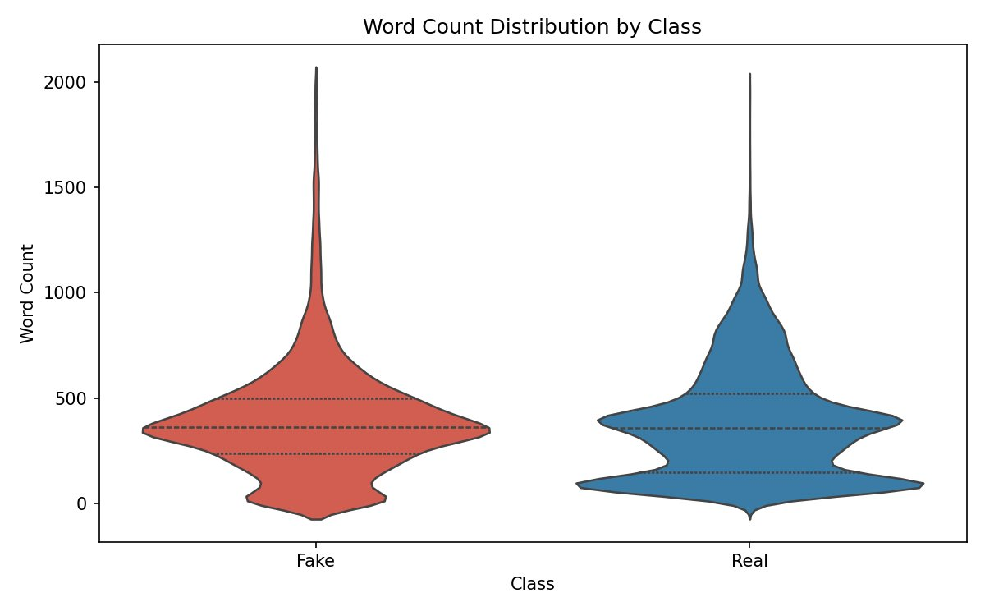
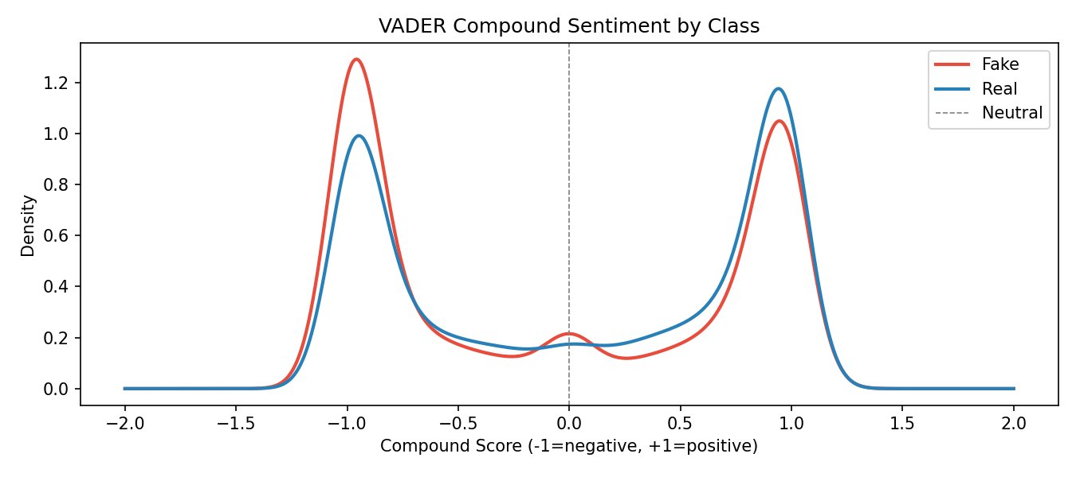
Phase 2 — Word Count & Sentiment Distributions
Word Count
VADER Sentiment
Similar medians (Fake: 363, Real: 359) but Real shows higher variance — bimodal distribution with more long-form content
Fake: stronger negative peak at −1.0, median −0.19. Real: dominant positive peak at +0.9, median +0.26. Both bimodal

Slide 8

Phase 2 — Vocabulary Differences: Word Clouds
Fake Vocabulary
Real Vocabulary
Key Distinction
Dominant: 'said', 'Trump', 'one', 'people'
'image via', 'pic', 'twitter' — web scraping artifacts
Opinion/emotional framing language
Dominant: 'said', 'government', 'Trump', 'White House'
'Reuters', 'Wednesday', 'United State' — formal reporting
Time/place references: structured journalism
Real news: day-of-week markers, official titles, datelines
Fake news: social media artifacts, informal language
→ Vocabulary alone highly discriminative

Slide 9
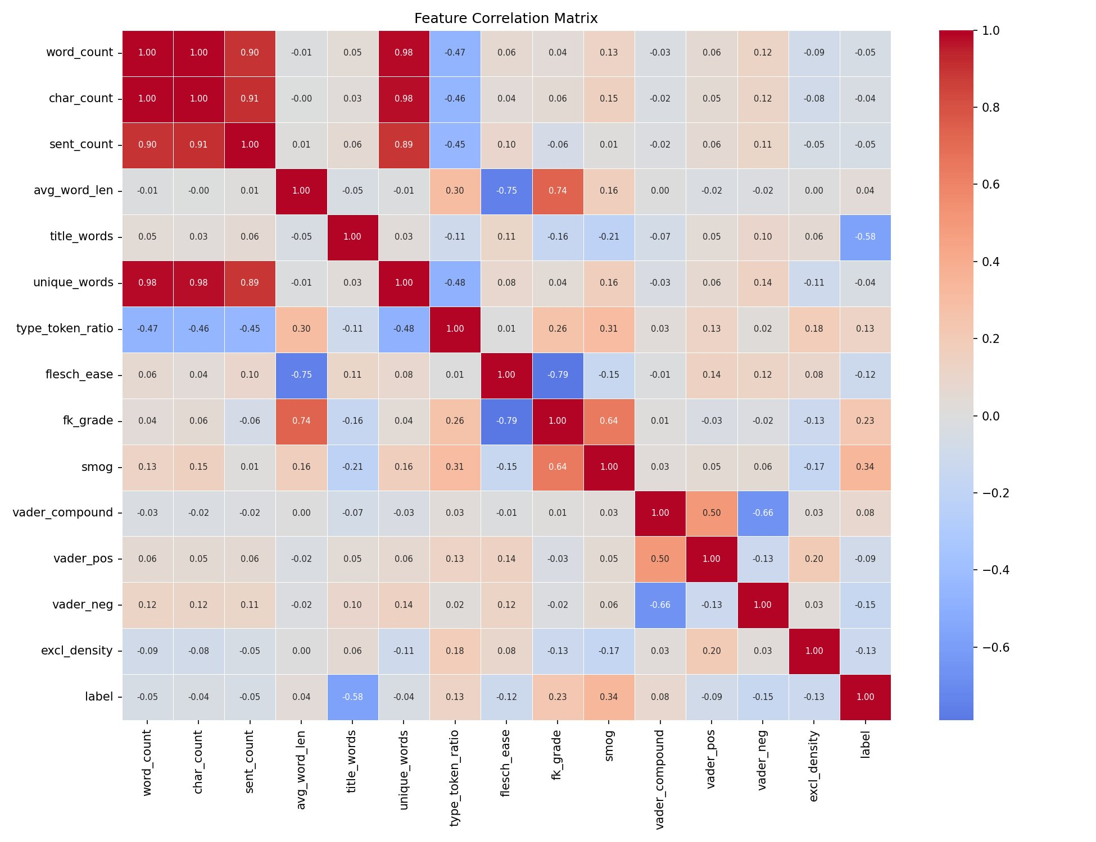
Phase 2 — Feature Correlation Matrix
Key Observations
word_count ↔ char_count
r = 1.00 — perfectly collinear
Only one needed in any model
flesch_ease ↔ fk_grade
r = −0.79 — expected inverse
Either alone is sufficient
title_words → label
r = −0.58 — strongest predictor
In Track C features
avg_word_len → label
r = +0.23 — real news uses
longer, more complex words
vader_compound ↔ vader_neg
r = −0.66 — expected structural
correlation in VADER
vader_pos → label
r = −0.09 — weak; polarity is
more complex than positivity

Slide 10
Phase 3 — Three Feature Tracks
Track A — Raw TF-IDF (Leaky Baseline)
44,898 × 50,000
A
Includes 'reuters', source bylines, scraped artifacts.
Any model trained here detects SOURCE identity,
not linguistic deception patterns.
⚠ LEAKY — for comparison only
Track B — Decontaminated TF-IDF
44,898 × 50,000
B
Reuters + source fingerprints removed.
0 articles still contain 'reuters' after cleaning.
LSA reduction → 300 SVD components (15.9% variance).
✓ Clean content-based features
Track C — Linguistic Style (14 features)
44,898 × 14
C
word_count, type_token_ratio, flesch_ease, fk_grade,
smog, vader_compound/pos/neg, excl_density,
avg_word_len, sent_count, title_words, caps_ratio, quest_density
✓ Interpretable, source-agnostic

Slide 11
Phase 3 — Step 3.4: Dimensionality Reduction with LSA
Why Reduce Dimensions?
Why Truncated SVD, Not PCA?
50K
Tree-based models are extremely slow on sparse matrices this large. Logistic Regression and SVM handle 50k directly, but ensemble methods need reduction.
Standard PCA limitation
Requires computing a dense covariance matrix (50,000 × 50,000 = 2.5B entries). For TF-IDF this would require enormous memory — computationally infeasible.
Track B features
300
Truncated SVD (LSA) compresses 50,000 sparse TF-IDF features into 300 dense semantic dimensions — 15.9% of variance retained.
Truncated SVD advantage
Works directly on the sparse TF-IDF matrix without materialising the dense covariance. Decomposes: X ≈ U · Σ · Vᵀ, keeping only top-300 singular values.
SVD components
~167×
This makes Random Forest and LightGBM tractable on Track B. The reduced representation captures latent topics across co-occurring terms.
LSA semantics
The resulting 300-dimensional space captures latent semantic relationships — words that appear in similar contexts are close together, even without direct co-occurrence.
compression ratio
Track B-LSA: 44,898 articles × 300 SVD components · Used for: Random Forest & LightGBM · Variance retained: 15.9% · Tracks A & B full-dim used for LR & SVM

Slide 12
Phase 3 — Text Preprocessing & Decontamination
1
Lowercase
2
Tokenise
3
Stopwords
4
Stem &
Lemma
5
⚠ Decontam.
All text converted
to lowercase
Normalise casing
Split into tokens
Punctuation stripped
Special chars removed
Remove common
function words
(NLTK stopwords)
Porter Stemmer
WordNet Lemmatiser
Reduce to root forms
Remove 'Reuters'
Source bylines
URL artifacts
Pub. signatures
→
→
→
→
Decontamination Details — What was removed and why
Reuters byline
99.8% of real articles → direct source ID, not linguistic content
Publication signatures
Author/outlet names uniquely identify real vs fake source
URL tokens (https, pic, flickr)
Web scraping artifacts in fake articles — not natural language signal
21wire, govtslaves domains
Known fake-news domain tokens that identify source not style
Result: 0 articles contain 'reuters' after decontamination · Models must learn linguistic patterns, not source identity

Slide 13
Phase 4 — Model Selection & Design Choices
LR
Logistic Regression
Tracks A, B, C
NB
Naïve Bayes (Multinomial + Complement)
Track B
Finds a straight-line decision boundary — each coefficient maps directly to a word/phrase. Most interpretable text classifier. L2 (Ridge): shrinks all coefficients, keeps all features active, stable with correlated terms. L1 (Lasso): drives unimportant features to zero — automatic vocabulary selection. Elastic Net: blend of L1+L2 for correlated TF-IDF features.
Assumes word independence given class — wrong in practice, but effective for text. MultinomialNB requires non-negative inputs (MinMaxScaler applied to 10,000-feature subset). ComplementNB models the opposite class for each prediction, which often outperforms standard MNB on near-balanced datasets like ISOT.
SVM
Linear SVM
Track B
RF
Random Forest
Tracks B-LSA, C
Finds the decision boundary maximising the margin between nearest fake/real articles. Maximum-margin property often gives better generalisation than LR. Linear kernel is best for high-dim TF-IDF — data is likely already linearly separable. Platt scaling (CalibratedClassifierCV) converts hard predictions to probabilities for ROC-AUC.
Builds many decision trees on random data/feature subsets; majority vote for final prediction. Too slow on 50,000 TF-IDF features — run on LSA-reduced Track B (300 features) and Track C (14 features). Track C comparison is most informative: can non-linear style patterns beat linear LR on interpretable features?
GBM
LightGBM
Tracks B-LSA, C
Gradient boosting growing trees leaf-by-leaf rather than level-by-level — faster and more accurate than XGBoost on many tasks. At each step, focuses on training examples with the biggest current errors. 300 estimators, learning rate 0.05. Applied to LSA-reduced Track B and Track C style features.

Slide 14
Phase 4 — Model Results Summary (5-Fold CV)
Model
Track
F1
AUC
Precision
Recall
Train Gap
LR-L2
A (Leaky)
0.9916
0.9993
0.9903
0.9929
0.0038
LR-L2
B (Clean)
0.9891
0.9991
0.9878
0.9904
0.0052
LR-L2
C (Style)
0.8778
0.9396
0.8513
0.9059
0.0002
Multinomial NB
B (Clean)
0.9575
0.9910
0.9571
0.9579
0.0042
Complement NB
B (Clean)
0.9572
0.9910
0.9552
0.9592
0.0046
SVM (Linear)
B (Clean)
0.9953
0.9997
0.9956
0.9950
0.0047
Random Forest
C (Style)
0.9198
0.9755
0.9119
0.9279
0.0587
Random Forest
B-LSA
0.9719
0.9962
0.9730
0.9709
0.0275
XGBoost
C (Style)
0.9219
0.9774
0.9051
0.9393
0.0202
LightGBM
B-LSA
0.9868
0.9989
0.9885
0.9851
0.0132
LightGBM
C (Style)
0.9266
0.9796
0.9121
0.9417
0.0345
★ Best clean model: SVM on Track B (F1 = 0.9953, AUC = 0.9997) · Track A inflated by source fingerprints · Track C is most interpretable

Slide 15
Phase 4 — F1 Score Comparison Across Models & Tracks

Slide 16
Phase 5 — Step 5.1: Why Accuracy Alone Is Not Enough
Accuracy counts the fraction of correct predictions. On near-balanced data it is a reasonable starting point, but it treats all errors as equally bad — and in fake news detection, these two errors have very different real-world consequences.
FP
False Positive — Real flagged as Fake
FN
False Negative — Fake slips through
Legitimate journalism suppressed. Real reporting from minor or non-Reuters outlets may match fake-news surface patterns. Risk: censorship of minority perspectives or unusual-format real news.
Misinformation reaches the audience unchecked. Professionally-written fake content mimicking real journalistic structure is most dangerous. Risk: public harm from unchecked disinformation.
Metric
What It Measures
Fake News Interpretation
Precision
Of all articles flagged as fake, what fraction truly are fake?
Controls false accusations against real journalism
Recall
Of all actual fake articles, what fraction did the model catch?
Controls how many fake articles slip through undetected
F1
Harmonic mean of Precision and Recall
Primary single-number comparison metric across models
ROC-AUC
Probability model ranks a random fake above a random real
Ranking quality — threshold-independent comparison
PR-AUC
Area under Precision-Recall curve
More informative than ROC when classes are slightly imbalanced

Slide 17
Phase 5 — Step 5.2: Final Hold-Out Evaluation (20% Test Set)
LR-L2 · Track B (Decontaminated)
SVM (Linear) · Track B (Decontaminated)
Class
Precision
Recall
F1
Support
Class
Precision
Recall
F1
Support
Fake
0.99
0.99
0.99
4,696
Fake
0.99
1.00
1.00
4,696
Real
0.99
0.99
0.99
4,284
Real
1.00
0.99
1.00
4,284
Macro avg
0.99
0.99
0.99
8,980
Macro avg
1.00
1.00
1.00
8,980
Weighted avg
0.99
0.99
0.99
8,980
Weighted avg
1.00
1.00
1.00
8,980
Confusion Matrix
Confusion Matrix
Pred Fake
Pred Real
Pred Fake
Pred Real
True Fake
4,634
62
True Fake
4,680
16
True Real
39
4,245
True Real
25
4,259
ROC-AUC: 0.9992 · PR-AUC: 0.9991
ROC-AUC: 0.9998 · PR-AUC: 0.9998 ★ Best model

Slide 18
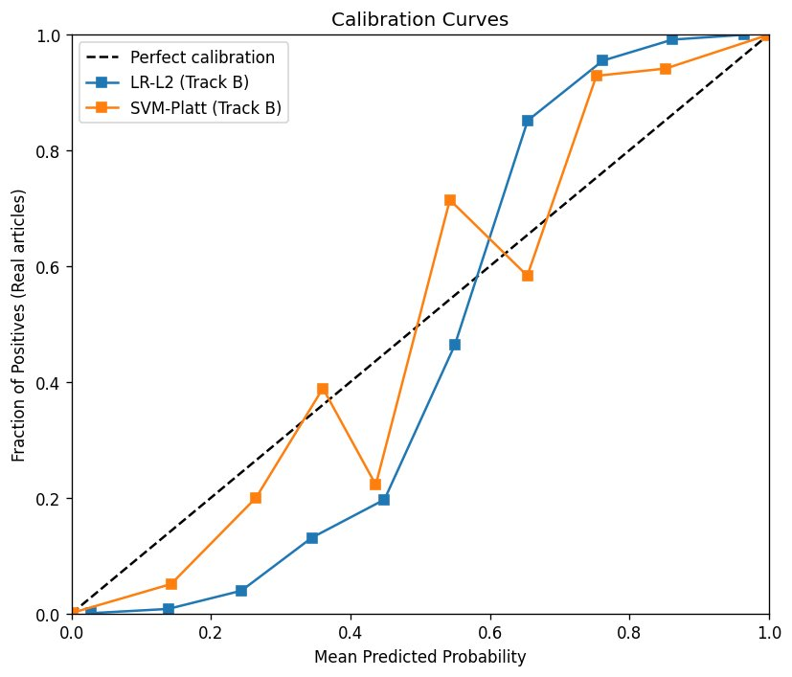
Phase 5 — Step 5.3–5.4: Statistical Test & Calibration Curves
McNemar's Test — LR-L2 vs SVM (Track B)
Step 5.4 — Calibration Curves (Reliability Diagrams)
McNemar's test evaluates whether two classifiers make systematically different errors on the same test set — not just which has a higher F1, but whether the difference is statistically real.
SVM Correct
SVM Wrong
LR Correct
8,877
2
LR Wrong
62
39
p-value: 2.26e-16 → SIGNIFICANT (p < 0.05)
SVM makes systematically fewer errors than LR — the performance difference is genuine, not due to random chance in the test split.
Error Analysis (LR): 39 FP — real flagged as fake (short/unusual format) · 62 FN — formal-looking fake that slipped through
LR-L2 (blue): Generally well-calibrated — predicted probabilities track observed frequencies closely.
SVM-Platt (orange): More erratic — Platt scaling partially corrects, but SVM probabilities are less reliable. Use LR when calibrated scores matter.

Slide 19
Phase 5 — Step 5.4: Error Analysis — LR-L2 (Track B)
Quantitative metrics tell us HOW OFTEN the model fails. Error analysis tells us WHY — enabling targeted improvements.
39 False Positives — Real Flagged as Fake
62 False Negatives — Fake Slipped Through
[politics] FOX NEWS LEGAL ANALYST: Comey's Big Lie…
[politicsNews] Hillary Clinton makes surprise appearance…
[worldnews] Russia's Lavrov says hopes Syrian congress…
[politics] MEGHAN MCCAIN Cut-Off After Saying…
[News] Someone Tried To Cash In On Antifa…
[politicsNews] Facebook's political influence under a microscope
[worldnews] Singapore man arrested for 'terrorism-related'…
[News] George Clooney HAMMERS Trump For Insulting…
[politicsNews] White House names Hicks interim comms dir.
[News] HEROIC Muslim Student Helps Track Down…
[worldnews] Malaysia's royals call for religious tolerance…
[left-news] HILLARY APPEARS Wearing Anti-Seizure Sunglasses…
[worldnews] Woman's murder prompts mass eviction of Syrians…
[politics] DIAMOND and SILK Have Message For GOP…
[News] Martin O'Malley Suspends Campaign (TWEET)
[News] Trump Admin Deals STUNNING Threat To Alaska…
Word count: mean 378 · median 377 · min 23 · max 932
Word count: mean 417 · median 401 · min 0 · max 1,244
Pattern: Sensational headlines (ALL CAPS, brackets like [Video], [TWEET]) and non-Reuters worldnews articles — model biased against informal-headline real news.
Pattern: Fake articles with [politicsNews] / formal-looking subjects — longer articles (mean 417 words) mimicking real journalistic structure. Model tricked by surface-level professionalism.

Slide 20
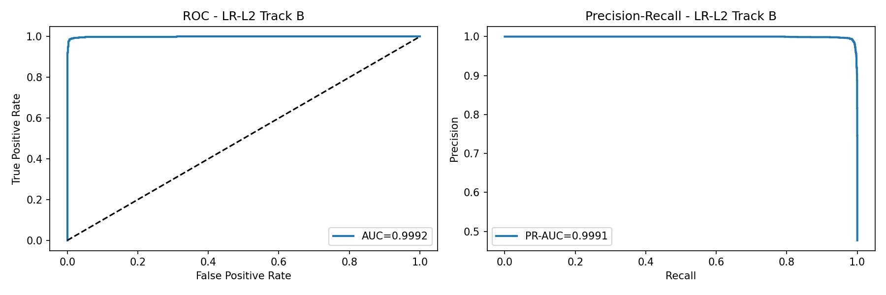
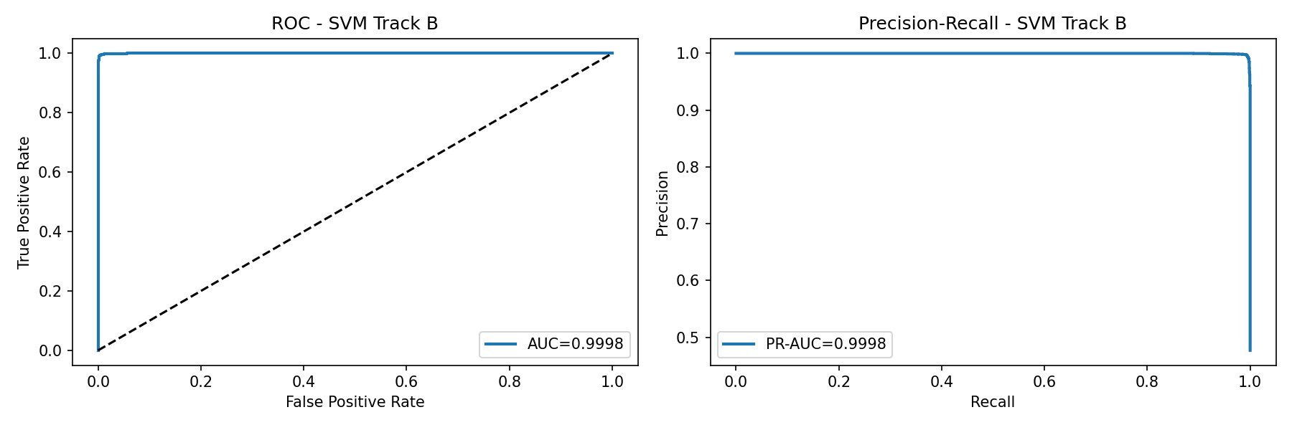
Phase 5 — Model Evaluation Curves (Track B, Decontaminated)
Logistic Regression — Track B
Support Vector Machine (Linear) — Track B
LR: AUC = 0.9992, PR-AUC = 0.9991 · SVM: AUC = 0.9998, PR-AUC = 0.9998 · Both near-perfect on clean Track B data

Slide 21
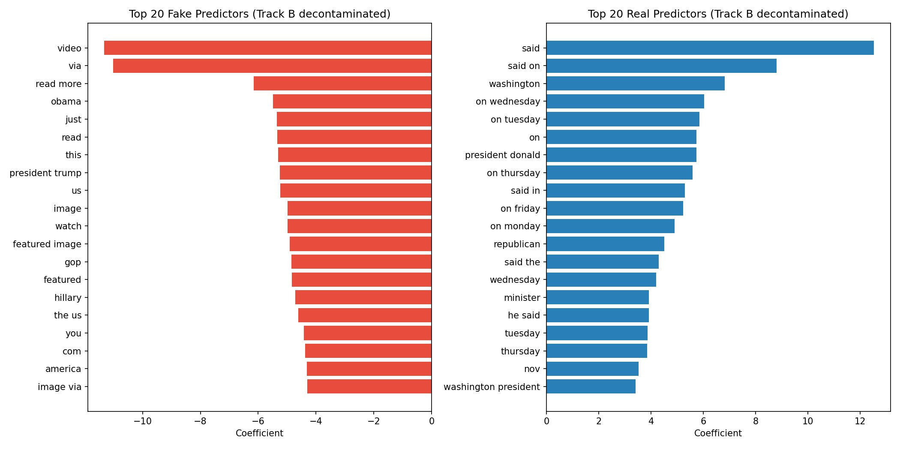
Phase 6 — Logistic Regression: Top Predictors (Track B)
Top Real Predictors
Top Fake Predictors
Key Insight
'said', 'washington', 'on wednesday/tuesday' — formal dateline reporting language, AP/Reuters style
'video', 'via', 'read more', 'image via' — social media sharing artifacts, engagement-bait language
After decontamination, model captures genuine journalistic style vs. informal web content — not just source identity

Slide 22
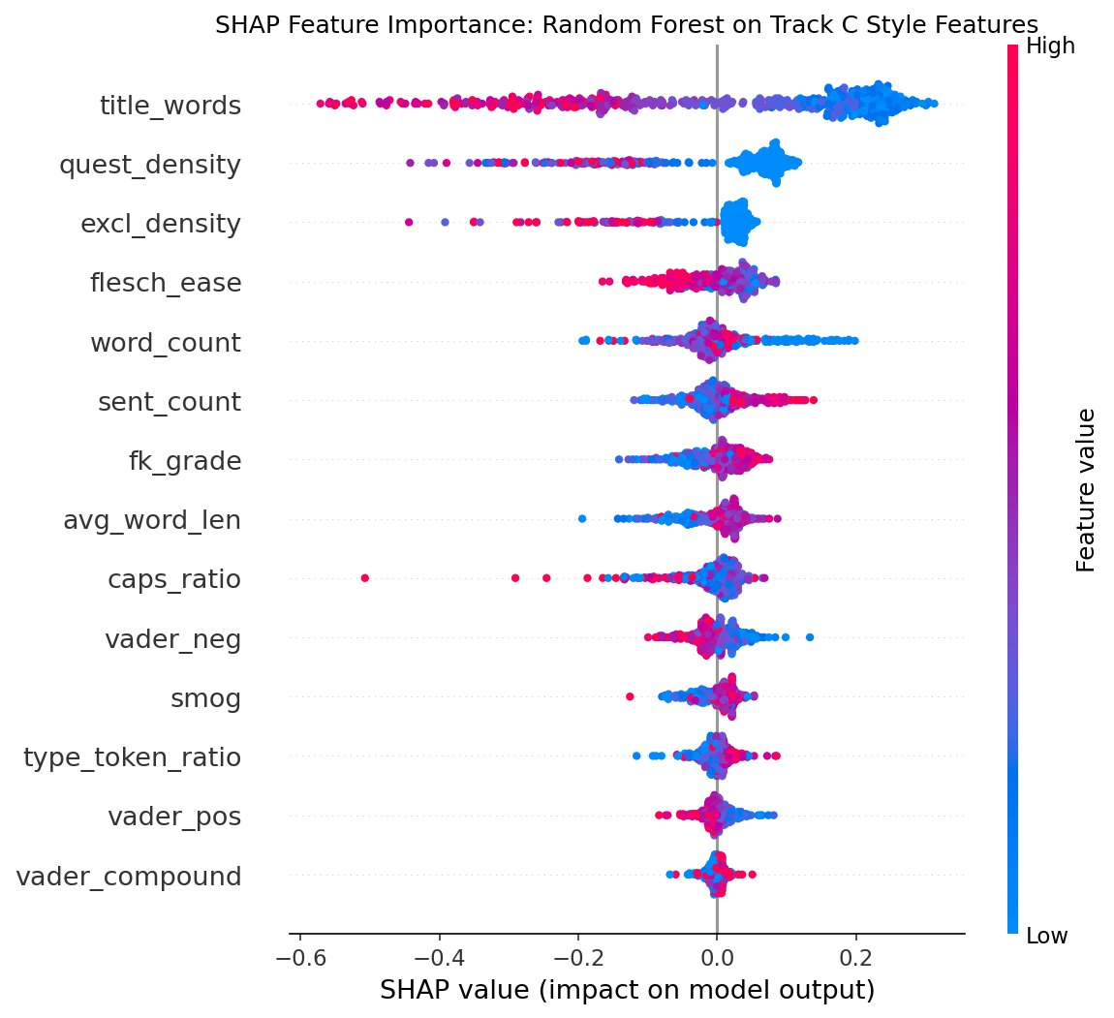
Phase 6 — SHAP Feature Importance: Random Forest (Track C)
SHAP Insights
title_words (top feature)
Low values (short titles) → Real
High values (long titles) → Fake
Strongest SHAP impact by far
quest_density & excl_density
High punctuation density pushes
toward Fake — sensationalist markers
flesch_ease
Higher ease score (simpler text)
pushes toward Fake classification
vader_neg & caps_ratio
Emotional amplification features;
caps_ratio has high-outlier Fake cases
type_token_ratio & smog
Higher vocabulary richness and
complexity → stronger Real signal

Slide 23
Key Research Findings — Phases 1–6
01
Dataset Integrity
02
Model Selection
03
Linguistic Evidence
Leakage Is Real — But Text Signal Is Genuine
Linear Models Outperform Complex Ones
Writing Style Is a Genuine Signal (Not Noise)
Subject (AUC=1.00) and Reuters (~99%) are pure shortcuts. Yet after full decontamination, LR F1 drops only 0.0025 and SVM actually improves (+0.0037). The text itself contains authentic discriminative signal beyond source identity.
SVM > LR >> RF/LGBM on clean TF-IDF. Train gap: SVM 0.005 vs RF 0.059. High-dim TF-IDF space is already linearly separable — additional model complexity adds variance, not discriminability. Occam's Razor holds.
14 style features → F1 0.88–0.93 with zero vocabulary. Title length (rb=−0.747) alone is the strongest predictor. Fake news is systematically shorter-titled, simpler (Flesch +8.7), more negative (VADER −0.19 vs +0.26). Style differences are statistically robust (p < 0.0083, Bonferroni).
04
Statistical Testing
05
Error Analysis
06
Critical Caveat
SVM Superiority Is Statistically Confirmed
Model Errors Reveal a Cognitive Boundary
Benchmark Limitations Constrain Conclusions
McNemar p = 2.26e-16. LR makes 62 errors SVM gets right; SVM makes only 2 errors LR gets right. This is a 31:1 asymmetry — not random variation. SVM's maximum-margin property provides genuine generalisation advantage on this data.
FP pattern: real news with sensational formatting (ALL CAPS, [TWEET]) — model penalises style, not truth. FN pattern: fake news with formal [politicsNews] labels and longer text (mean 417 words) — model is fooled by surface professionalism. Errors cluster at the style-truth crossover zone.
6,252 duplicate texts, 6,852 near-duplicates, single domain (US political 2015–2017), temporal imbalance (33,030 missing dates). Even Track B/C F1 ≥ 0.99 should not be read as real-world performance. Cross-domain generalisation remains unvalidated.

Slide 24
Limitations, Implications & Future Directions
Current Limitations
Future Directions
Single domain bias
Cross-domain evaluation
US political news only (2015–2017). Performance likely degrades on satire, scientific misinformation, or non-English content.
Test on LIAR, FakeNewsNet, CREDBANK datasets. Measure how much Track B/C performance degrades across domains and time periods.
Temporal contamination risk
Transformer-based models
Near-duplicates across train/test splits may inflate reported F1. True held-out performance on future data is unknown.
BERT/RoBERTa on decontaminated Track B — can contextual embeddings capture subtler deception patterns that TF-IDF misses?
No context modelling
Adversarial robustness testing
Models see article text only — no author history, sharing network, metadata provenance, or claim verification against knowledge bases.
Paraphrase attack: rewrite fake articles to mimic real vocabulary. Quantify how much F1 drops — tests whether the model learned meaning or surface form.
Static vocabulary
Calibration-aware deployment
TF-IDF trained on 2015–2017 language. Adversarial actors can adapt style; a static model cannot track evolving deception strategies.
Use LR's well-calibrated probabilities for priority queuing rather than hard thresholding. Build reject-option classifier for ambiguous cases.

Slide 25
Thank You
Questions & Discussion
Hareen Sai Vatikuti · Raj Purohith Arjun · Venkateswarlu Nagineni
STAT 654 · Texas A&M University
ISOT Dataset · Phases 1–4 · 44,898 Articles · 5-Fold Stratified CV

